Slide 1
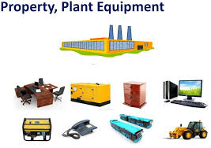
Asset Valuation as per Ind AS – 16

Slide 2
Learning Outcomes
Appraise the accounting treatment of property, plant and equipment.
Recognize the scope of Ind AS 16 used in relation to accounting for fixed assets.
Analyze the criteria for recognition of costs related to property, plant and equipment.
Measure the costs of the fixed assets using the cost model.
Comprehend the importance of impairment of assets and its’ recognition in financial statements.

Slide 3
PPE as per Ind AS 16
Prescribe the accounting treatment for properties, P&E (Plant and Equipment).
Helpful to users of financial statements so as to recognize changes made in PPE.
It deals with addition, disposal, acquisition, and expenditure incurred on Fixed Asset.

Slide 4
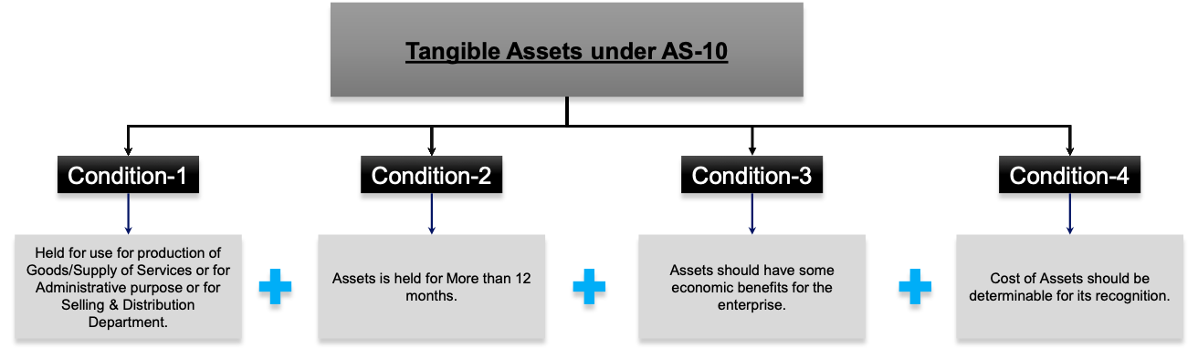
A). Recognition of Tangible Assets (Ind AS – 16)
PPE
4 Conditions in PPE as per (Ind AS 16)

Slide 5
PPE (Property, Plant & Equipment)
Following tangible assets are grouped into classes of property, plant and equipment for the purpose of disclosure in the financial statements.
Land and buildings;
Plant and equipment;
Furniture and vehicles;
Computer hardware;
Leased assets.
Office equipment

Slide 6
B.) Initial recognition
An item of property, plant, equipment and investment property should be recognised as an asset when:
Future economic benefits are expected to flow;
and b) The cost of the asset can be measured reliably

Slide 7
PPE or not? (Analysis using Flow Chart)
Resource controlled by the company?
No
Yes
EXPENSE
Future economic benefits are expected?
No
Yes
ASSET
No
To be used for production, commercial or administrative purposes?
ANOTHER ASSET
Yes
No
Expected to be used during more than one year?
Yes
No
Not Recognised
Can be measured reliably?
Yes
P,P&E

Slide 8
Poll – I
Which of the following statements is false with regard to Property, Plant and Equipment as per Ind AS 16?
They are normally used in business on short term basis uptil 12 months.
They are used in production process to manufacture goods which are sold in market.
Their price can be measured suitably from their purchase invoice.
They are not held for sale in the normal course of business.
Notes:
A

Slide 9
C.) Initial Measurement
An item of property, plant, equipment which qualifies for recognition as an asset should be measured at cost.
Where an asset is acquired at no cost, its cost will be its fair value at the date of acquisition.
Notes:
Fair value of an asset is the amount paid in a transaction between participants if it's sold in the open market. A willing buyer and seller have agreed upon this value.

Slide 10
Components of Cost Price
The cost of an item = its purchase price, plus
Import duties; and
Any directly attributable costs of bringing the asset to working condition for its intended use, such as:
Cost of site preparation;
Initial delivery and handling costs;
Installation costs;
Professional fees such as architects and engineers, legal services; and
Estimated cost of dismantling the asset and restoring the site.
Any trade discounts or rebates are deducted.

Slide 11
Subsequent expenditure
Subsequent related expenditure incurred by the company must be added to the carrying value i.e. (cost of asset – depreciation) of the asset when:
It is determined that it will provide future economic benefits.
It will improve the condition of the asset.
Otherwise subsequent expenditures must be recognised as expenses.

Slide 12
Examples of Subsequent expenditure
Modification made in the plant for the purpose of improving its capacity.
Upgradation made in the machinery to improve the quality of final output.
Adoption of new production process for the purpose of reducing the operating costs.

Slide 13
Poll – II
Q. A company has purchased a machinery for $10,000 in the year 2019. Which of the following is not an appropriate basis for measuring the cost of this machinery?
Delivery and handling costs and installation costs of a machinery should be included in the machinery cost.
The cost should include the purchase price without a deduction for trade discounts.
The costs of improvements to equipment incurred after its acquisition should be added to the machinery cost if they provide future economic benefits.
All costs incurred in the construction of a machinery, from dismantling to erection, should be considered as part of the machinery cost.
Notes:
b

Slide 14
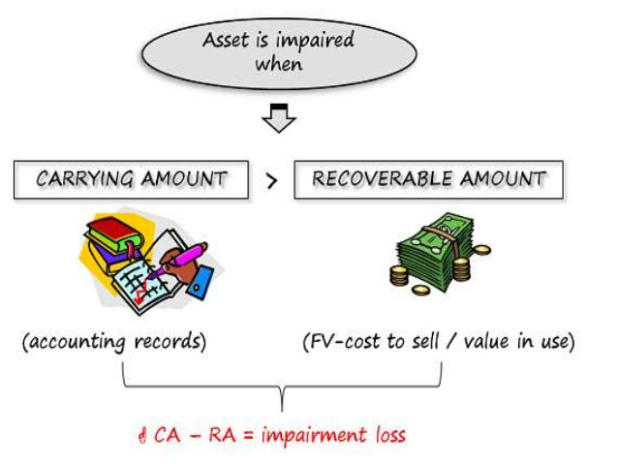
D.) Impairment of Assets
Occurs due to:
Physical damage to asset
Reduction in Market Value of asset
Decrease in the asset’s functionality
Cessation of demand served by that asset

Slide 15
Impairment of Assets – Example
A company is using the machinery X for past 5 years for the production.
The current carrying value of the machinery X is $4000
However, in the market, there are new machines available which are having new technology. These machines produce the products in less time and also save significant costs.
It is estimated that machinery X, if sold in the market on current date, will generate the cash flow of $1000 only.
In this case, the company is having impairment loss on machinery X for $3000.

Slide 16
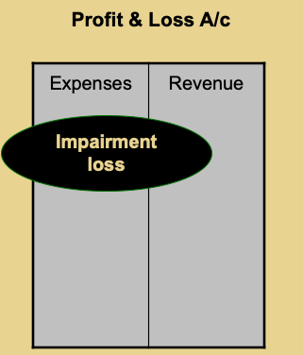
Recognition of Impairment Loss

Slide 17
Poll – III
In accordance with Ind – AS 16 , which of the following would definitely NOT be an indicator of the potential impairment of an asset (or group of assets)?
An unexpected fall in the market value of one or more assets
Adverse changes in the economic performance of one or more assets
A significant change in the technological environment in which an asset becomes obsolete.
The carrying amount of an entity’s net assets being below the realisable value.
Notes:
D

Slide 18

CONFUSED!
ANY QUESTIONS?

